Slide 1
Large-scale Graph Mining with Spark
What I learned from mapping >15 mm websites
Win Suen
PyGotham 2018

Slide 2
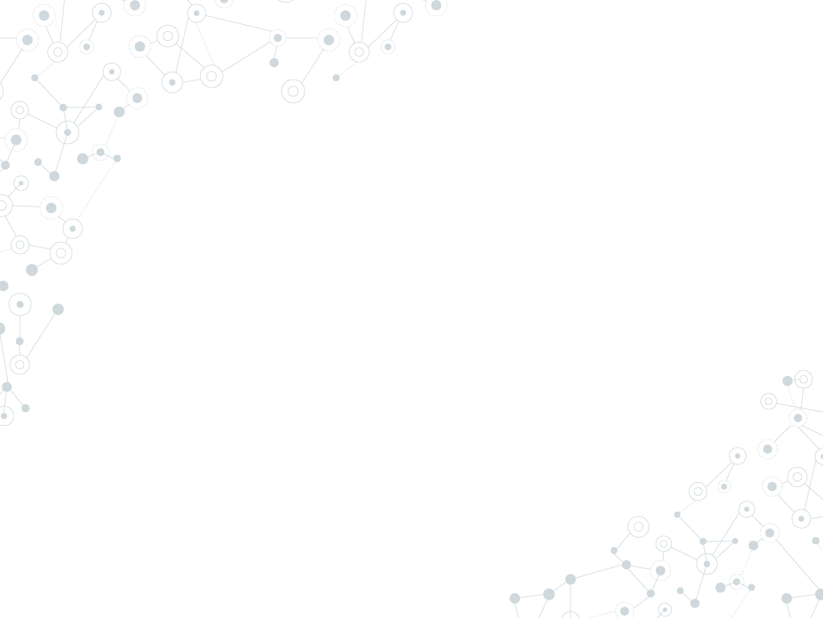

Hello!
I am Win Suen
Data Scientist @ AppNexus.
Avid hiker.
Reader of books and papers.

Slide 3
1.
Why graphs?

Slide 4
Why do I love graphs?
Graphs encode valuable, implicit information.
Many practical computing problems rely on graphs.
Graphs are fascinating!

Slide 5
Graphs for problem solving

Slide 6
Graph exploration :
Efficiently finding structure or knowledge in a graph, even if we don’t know exactly what we are looking for.
(Mottin and Müeller, KDD’18)

Slide 7
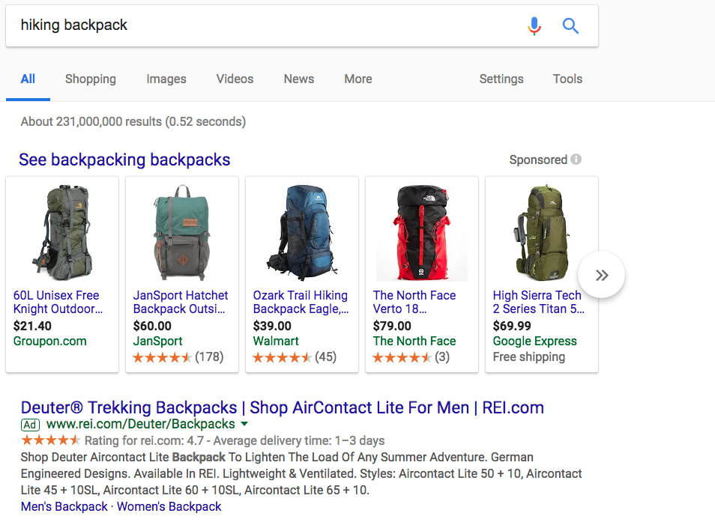
Maximal matching and allocation
Search query
Search ads

Slide 8
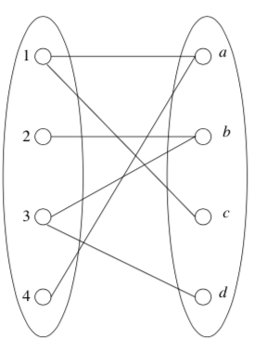
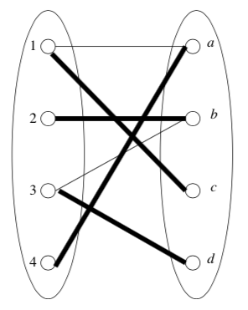
Maximal matching and allocation
Leskovec, Jure, Anand Rajaraman, and Jeffrey David Ullman. Mining of massive datasets. Cambridge University Press, 2014.

Slide 9
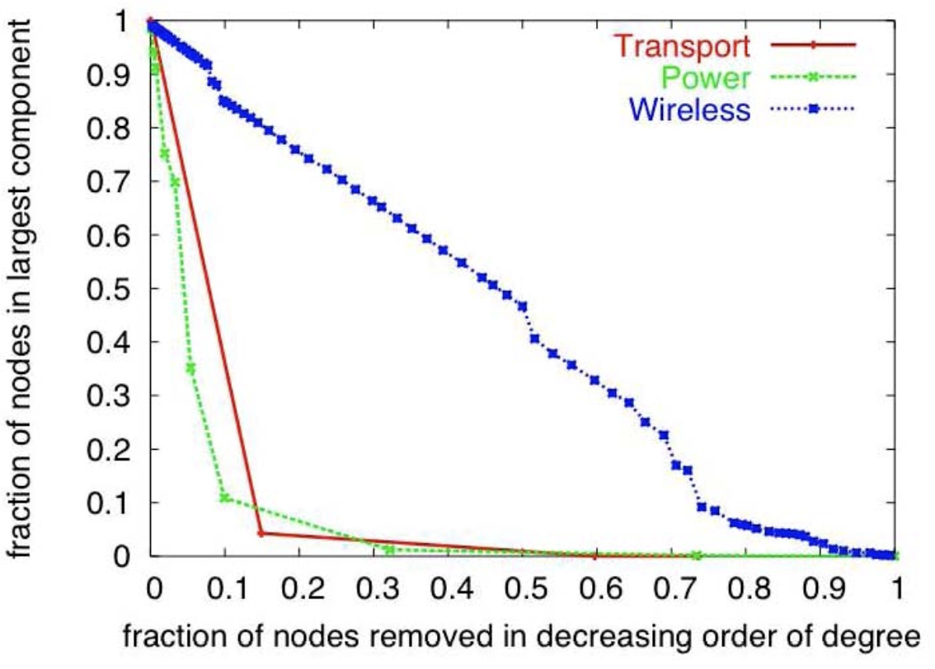
Infrastructure
Atkins, Karla, et al. "The structure of electrical networks: a graph theory based analysis." International Journal of Critical Infrastructures 5.3 (2009): 265-284.

Slide 10
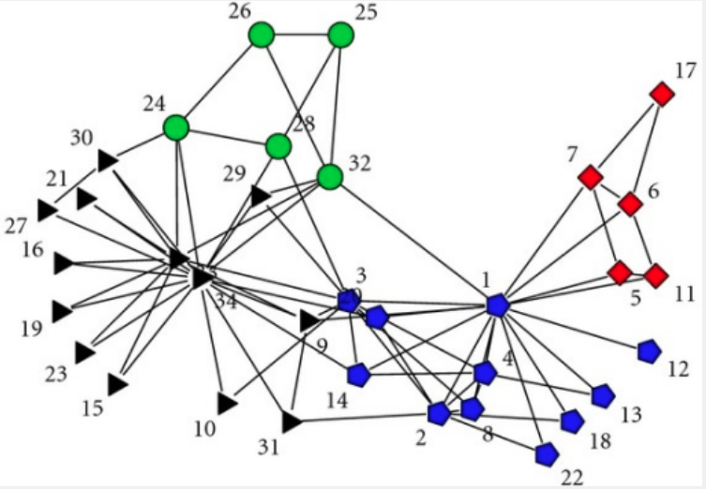
Social networks: communities
Zachary karate club network dataset -- KONECT, April 2017.

Slide 11
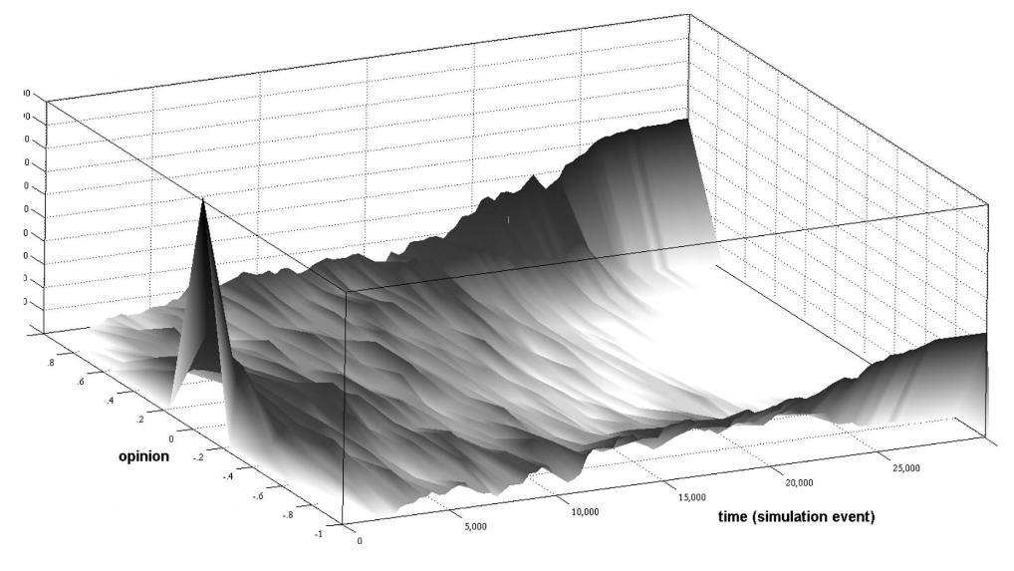
Social networks: polarization
Garimella, Morales, et al, KDD 2018.

Slide 12
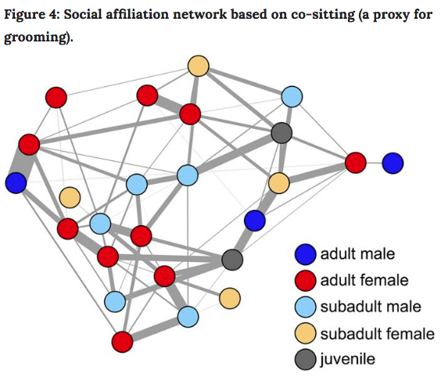
Behavioral ecology
Farine, Damien R., et al. "Both nearest neighbours and long-term affiliates predict individual locations during collective movement in wild baboons." Scientific reports 6 (2016): 27704

Slide 13
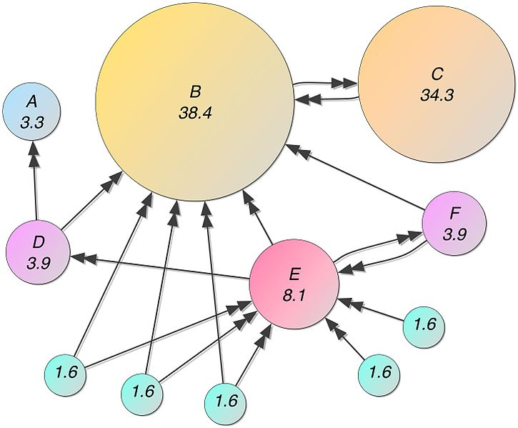
Web structure

Slide 14
2.
Web graphs

Slide 15
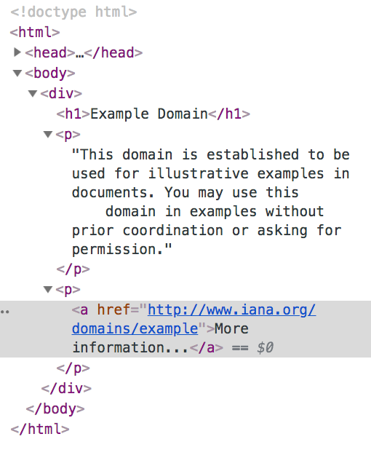
Webgraphs
Parent node: example.com
(directed edge)
Child node: iana.org

Slide 16
Webgraphs: substructures
About
Homepage
Sports article
Sports page

Slide 17
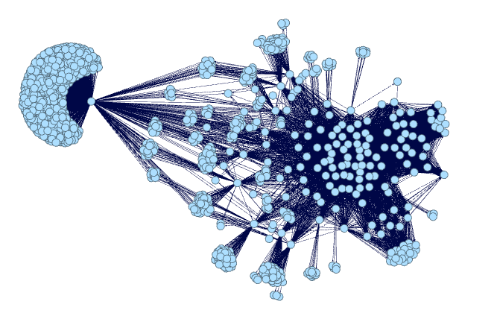
Webgraphs: larger structures
Subpage structure of webpages in a news site, generated by me using Gephi.

Slide 18
Web graphs encode information about:
Communities
Categories
Traffic

Slide 19
3. Spark

Slide 20
Graph Libraries
Tool | Graph size | Is_python | Visualization included
networkx | Single machine. | Yes. | Yes, some.
Gephi | Single machine. | No. | Yes.
Spark GraphFrames | Multiple machines. | Yes. | Yes, plug in other libraries.
Apache Giraph | Multiple machines. | No. | No.
Neo4j | Multiple machines. | No. | Yes.
Bespoke solutions (here be dragons) | Many more machines. | ? | ?

Slide 21
Why choose GraphFrames?
Processes data too large to fit on single machine.
Provides parallelism in data input.
Provides parallelism in processing.
Has some fault tolerance.
Integrates nicely with other python packages.

Slide 22
What I did
Clean Common Crawl dataset. Select files, write custom parser that read warc files, extracted links from html.
Load graph into Graphframes.
Filter, clean, repeat. Do this, a lot.
Try to detect communities.

Slide 23
The top of the iceberg is what I’m talking about
Won’t talk about:
data parsing
inconclusive algorithms and results
trials and many, many errors ☺
See my Medium post for more gory detail.

Slide 24
Creating a GraphFrame

Slide 25
Fun things to do with GraphFrames

Slide 26
3. Community Detection

Slide 27
Advantages of LPA
Labelled data is not required.
External parameter setting is nice, but not strictly necessary.
Runs in near linear time.
Raghavan, Usha Nandini, Réka Albert, and Soundar Kumara. "Near linear time algorithm to detect community structures in large-scale networks." Physical review E 76.3 (2007): 036106.

Slide 28
Converges within 5 - 6 iterations for sampled Common Crawl data.

Slide 29
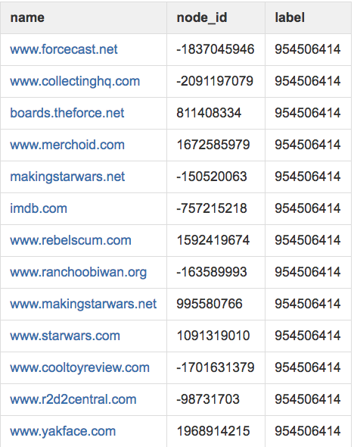
Community: fandoms
Sites related to Star Wars memorabilia.

Slide 30
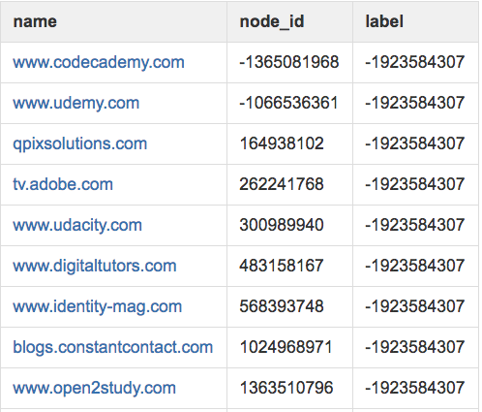
Community: online learning
Mixed community of online learning sites, sites that link to these sites .

Slide 31
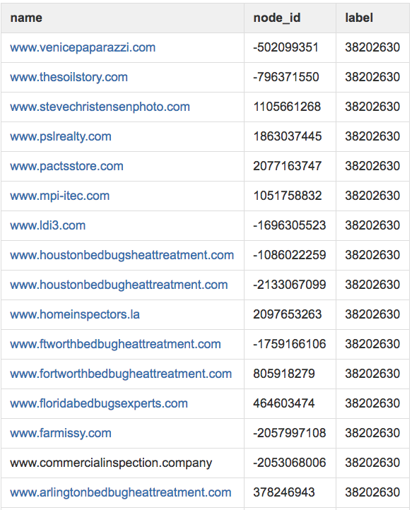
Community: bedbugs
Cookie cutter bedbug sites and sites with similar content resources.

Slide 32
89,526,124
Whoa! That’s a big number, aren’t you proud?

Slide 33
89,526,124
185,244 users
100%
That’s a lot of nodes
And a lot of websites
Total success!

Slide 34

Let’s review some concepts
Yellow
Is the color of gold, butter and ripe lemons. In the spectrum of visible light, yellow is found between green and orange.
Blue
Is the colour of the clear sky and the deep sea. It is located between violet and green on the optical spectrum.
Red
Is the color of blood, and because of this it has historically been associated with sacrifice, danger and courage.
Yellow
Is the color of gold, butter and ripe lemons. In the spectrum of visible light, yellow is found between green and orange.
Blue
Is the colour of the clear sky and the deep sea. It is located between violet and green on the optical spectrum.
Red
Is the color of blood, and because of this it has historically been associated with sacrifice, danger and courage.

Slide 35
Thanks!
Any questions?
Find me at:
wsuen@appnexus.com
Github:
Medium tutorial:

Slide 36
SlidesCarnival icons are editable shapes.
This means that you can:
Resize them without losing quality.
Change line color, width and style.
Isn’t that nice? :)
Examples:

